Slide 1
Friday,December 31st 2021
UNIT 6 : Our Tet holiday
Lesson 7:Looking back & project p.66-67

Slide 3
Vocabulary
Grammar
Match the verbs on the left with the nouns on the right.
Write full sentences using the cues given, and should or shouldn’t.
Complete the sentences with the words / phrases in the box.
Read the passage and fill the blanks with some or any.

Slide 4
Vocabulary

Slide 5
Match the verbs on the left with the nouns on the right.
1.
1 - d
a.
d.
give lucky number
give
a wish
lucky number
2 - c
c.
2.
b.
cook special food
special food
cook
fireworks
3 - e
e.
3.
c.
trees
plant
plant trees
special food
4 - a
a.
4.
d.
a wish
make
make a wish
lucky number
5 - b
b.
5.
e.
watch fireworks
fireworks
watch
trees
6 - f
f.
6.
f.
break things
things
break
things

Slide 6
Complete the sentences with the words / phrases in the box.
gathering
cleaning
lucky money
banh chung
peach
lucky money into red envelopes.
1.
At Tet, my mother puts
into red envelopes.
2.
What are you doing?
I’m
cleaning my bedroom.
my bedroom.
Banh chung is special for Tet.
3.
is special for Tet.
peach
4.
We have flowers only at Tet.
5.
When everybody is at home together,
we call it a family
gathering.
.

Slide 7
Grammar

Slide 8
Write full sentences using the cues given, and should or shouldn’t.
1.
Ask for permission before entering a room
He / She
should ask for permission before entering a room.
2.
Run about the house
He / She
shouldn’t run about the home.
3.
Take things from a shelf
He / She
shouldn’t take things from a shelf.
4.
Make a lot of noise
He / She
shouldn’t make a lot of noise.
5.
Ask for some water if he / she feels
He / She
should ask for some water if he / she feels thirsty.

Slide 9
Read the passage and fill the blanks with some or any.
My room is ready for Tet. By the window are (1) balloons. There is a picture I made from (2) old magazines. It’s colourful, but I didn’t use (3) paint or colour pencils. I love flowers, but I don’t have (4) yet. Oh, look at this new plant. It needs (5)
water, but it doesn’t need (6) sunlight. It can live in a room.
some
some
any
any
some
any

Slide 10
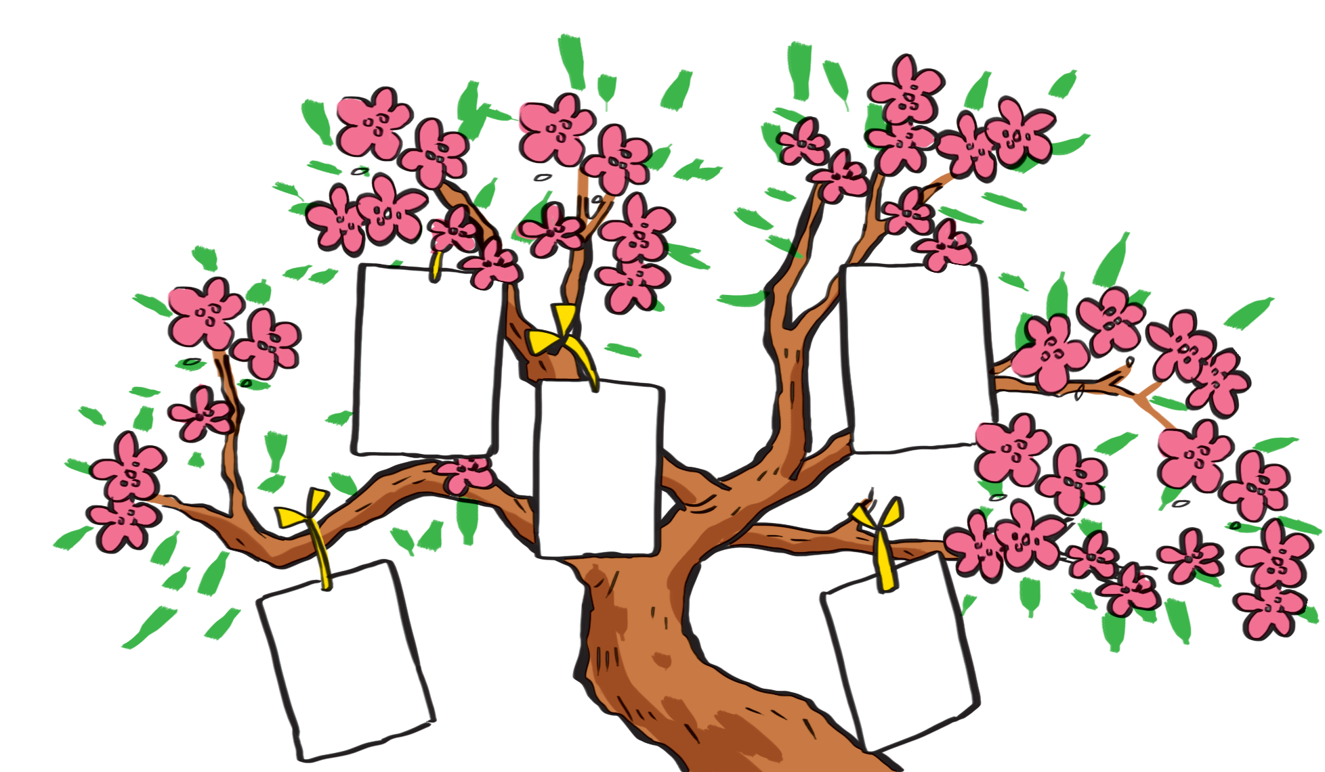
I want to have a brother.
I want to visit Singapore
I want to live in a tree house.

Slide 11
I wish
1.
Each student gets a small piece of paper and writes his / her wishes on it.
2.
He / She hangs it on a tree.
3.
Other students take turns to come up, get a piece of paper and read aloud the wish.
4.
The class guess whose wish it is.

Slide 12
Now I can … |  |  | 
use the words related to things and activities at Tet.
pronounce the sounds /s/ and /ʃ/ correctly.
use should / shouldn’t for advice.
use some / any for amount.
say New Year’s wishes.
read about New Year’s practices.
talk about what children should / shouldn’t do at Tet.
listen about preparations for Tet.
write an email about what children should / shouldn’t do at Tet.
✓
✓
✓
✓
✓
✓
✓
✓
✓
✓
✓
✓
✓
✓
✓
✓
✓
✓
✓
✓
✓
✓
✓
✓
✓
✓
✓

Slide 13
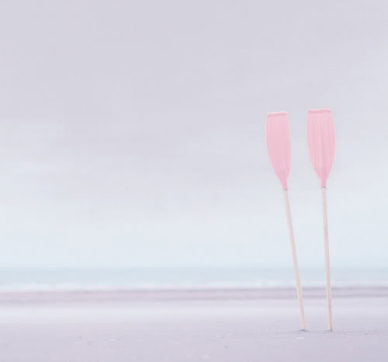
Home Assignments
Revise the new words
- Prepare the new lesson : Review 2 (unit 4-5-6)

